Slide 1

Java Webservices (SOAP + REST), POSTMAN
Java Full Stack Program

Slide 2
What is REST in Web Services?
REST stands for Representational State Transfer, which is a popular architectural style for designing web services.
It is an approach for building distributed systems that are scalable, lightweight, and easy to maintain.
REST is based on a few key principles, which include:
1. Resource identification through URIs:
Each resource in a RESTful web service should be identified by a unique Uniform Resource Identifier (URI).
The URI should represent the state of the resource and be used to perform operations on that resource.
2. Uniform interface:
RESTful web services should have a uniform interface that is consistent across all resources.
This interface should use standard HTTP methods like GET, POST, PUT, and DELETE to perform operations on resources.
Java Full Stack Program

Slide 3
3. Stateless:
RESTful web services should be stateless, meaning that each request from the client to the server should contain all the necessary information to complete the request.
The server should not store any client-specific data between requests.
4. Representations:
RESTful web services should use representations to represent resources.
Representations can be in various formats such as JSON, XML, or HTML.
5. Hypermedia as the engine of application state (HATEOAS):
RESTful web services should use hypermedia links to enable the client to discover and navigate the available resources dynamically.
Java Full Stack Program

Slide 4
Consuming RESTful Web Services with Java
1. Choose a library/framework:
There are several libraries/frameworks available to consume RESTful web services in Java such as Spring Boot, Jersey, Apache CXF, and RESTEasy.
Choose the one that fits your needs the best.
2. Create a Java class:
Create a Java class that will handle the RESTful web service request/response.
3. Add the required dependencies:
Add the required dependencies to your project, depending on the library/framework you chose.
4. Define the base URL:
Define the base URL of the RESTful web service that you want to consume.
Java Full Stack Program

Slide 5
5. Create an instance of the REST client:
Create an instance of the REST client using the library/framework that you chose.
6. Make a request:
Use the instance of the REST client to make a request to the RESTful web service.
7. Parse the response:
Parse the response that you receive from the RESTful web service.
8. Handle errors:
Handle any errors that may occur during the request/response process.
Java Full Stack Program

Slide 6
Here is an example code snippet that uses the Jersey framework to consume a RESTful web service:
import javax.ws.rs.client.Client;
import javax.ws.rs.client.ClientBuilder;
import javax.ws.rs.client.WebTarget;
import javax.ws.rs.core.MediaType;
public class RESTClient {
public static void main(String[] args) {
Client client = ClientBuilder.newClient();
WebTarget target = client.target("http://example.com/api");
String response = target.path("resource").request(MediaType.APPLICATION_JSON).get(String.class);
System.out.println(response);
}
}
Java Full Stack Program

Slide 7
In this example, we are using the “ClientBuilder” class to create a new “Client” instance.
We then create a “WebTarget” instance using the base URL of the RESTful web service.
We make a request to the RESTful web service using the “get()” method of the “WebTarget” instance, and we specify the media type of the response we expect using the “request()” method.
Finally, we parse the response as a string and print it to the console.
Java Full Stack Program

Slide 8
To test RESTful web services in Java, you can use the following steps:
Choose a testing framework: There are several testing frameworks available in Java such as JUnit, TestNG, and REST Assured. Choose the one that fits your needs the best.
Set up your test environment: Create a test environment that allows you to test your RESTful web service. This could be a local server or a test server.
Create a test class: Create a test class that will test the RESTful web service.
Add the required dependencies: Add the required dependencies to your project, depending on the testing framework you chose.
Write test cases: Write test cases that will test the functionality of the RESTful web service.
Run the tests: Run the tests and verify that they pass.
Handle errors: Handle any errors that may occur during the testing process.
Java Full Stack Program

Slide 9
Here is an example code snippet that uses the REST Assured framework to test a RESTful web service:
import static io.restassured.RestAssured.*;
import static org.hamcrest.Matchers.*;
import org.junit.Test;
public class RESTServiceTest {
@Test
public void testGet() {
given().
contentType("application/json").
when().
get("http://example.com/api/resource").
then().
statusCode(200).
body("property", equalTo("value"));
}
}
Java Full Stack Program

Slide 10
In this example, we are using the REST Assured framework to test a GET request to a RESTful web service.
We use the “given()” method to set the content type of the request, and we use the “when()” method to make the request.
We use the “then()” method to verify the response by checking the status code and the body of the response.
We use the “equalTo()” method to check the value of a specific property in the response.
This is just a simple example, and there are many other ways to test RESTful web services using Java testing frameworks.
It's important to write comprehensive tests to ensure that your RESTful web service is functioning as expected.
Java Full Stack Program

Slide 11
Future of RESTful Web Services in Java.
RESTful web services have become a popular way to build distributed systems that can communicate over the internet.
REST has been around for more than a decade and has proven to be a flexible and scalable architecture style for building web services.
While there are other architectures and protocols that are emerging as alternatives to REST, RESTful web services in Java are still widely used and are likely to continue to be used for the foreseeable future.
Here are some of the trends and technologies that are shaping the future of RESTful web services in Java:
1. Microservices:
RESTful web services are often used in microservices architectures, where each service is built and deployed independently.
Microservices allow for greater flexibility and scalability, and RESTful web services are a natural fit for building these types of architectures.
Java Full Stack Program

Slide 12
2. Containerization:
Containerization technologies like Docker and Kubernetes have made it easier to deploy and manage RESTful web services in Java.
Containers provide a lightweight and portable way to package and deploy web services, making it easier to manage infrastructure and scale services.
3. Cloud computing:
Cloud computing platforms like Amazon Web Services (AWS), Microsoft Azure, and Google Cloud Platform (GCP) have made it easier to deploy and scale RESTful web services in Java.
Cloud platforms provide a range of services and tools for deploying, managing, and monitoring web services.
4. API management:
API management platforms like Apigee, MuleSoft, and Kong provide a range of tools and services for managing and securing RESTful web services in Java.
These platforms can help organizations to build, deploy, and manage APIs at scale.
Java Full Stack Program

Slide 13
5. GraphQL :
GraphQL is an alternative to REST that has gained popularity in recent years.
GraphQL is a query language that allows clients to specify the data they need, making it more efficient and flexible than REST.
While GraphQL is not a replacement for REST, it can be used alongside RESTful web services to provide more efficient and flexible APIs.
In conclusion, while there are alternative architectures and protocols emerging, RESTful web services in Java are likely to remain popular and widely used in the future, especially in microservices architectures.
It's important to stay up-to-date with the latest trends and technologies in the field to ensure that your RESTful web services are efficient, reliable, and scalable.
Java Full Stack Program

Slide 14
Advantages of Rest in Java Web Services
Simplicity: RESTful web services are simple to understand and implement. They use HTTP as the transport protocol and rely on a set of well-defined methods (GET, POST, PUT, DELETE) to interact with resources.
Flexibility: RESTful web services are highly flexible and can be used to build a wide range of applications, from simple CRUD (Create, Read, Update, Delete) operations to complex distributed systems.
Scalability: RESTful web services are highly scalable, making them well-suited for building large-scale systems that can handle high traffic loads.
Interoperability: RESTful web services are based on open standards like HTTP and JSON, which makes them highly interoperable. They can be used to build systems that can communicate with a wide range of clients and servers.
Caching: RESTful web services can take advantage of HTTP caching, which can improve performance and reduce the load on the server.
Java Full Stack Program

Slide 15
Disadvantages of Rest in Java Web Services
1. Lack of strong typing:
RESTful web services use JSON or XML to represent data, which can lack strong typing.
This can make it more difficult to validate data and can lead to errors if the data is not well-formed.
2. Security:
While RESTful web services can be secured using HTTPS and other security measures, they can be vulnerable to attacks like CSRF (Cross-Site Request Forgery) and XSS (Cross-Site Scripting) if not properly secured.
3. Overhead:
RESTful web services can have some overhead, especially when dealing with large payloads or complex data structures.
This can impact performance and increase the load on the server.
Java Full Stack Program

Slide 16
4. Complexity:
While RESTful web services are relatively simple to understand and implement, they can become more complex when dealing with advanced features like HATEOAS (Hypermedia as the Engine of Application State).
5. Limited functionality:
RESTful web services are focused on resource-based interactions, which can limit their functionality in some cases.
Other architectures like SOAP (Simple Object Access Protocol) can provide more advanced features like transactions and security policies.
Java Full Stack Program

Slide 17
APIGEE - API Management Platform - (Introduction, Basic
Concepts, KVM, Caching, Flows, Debugging, Security
Java Full Stack Program

Slide 18
What is Apigee?
Apigee can be defined as a platform for creating and handling the APIs. An Application programming interface (API) acts as a single-window or entry point for a defined set of microservices and handles protocol translations. Many services are assured by way of RESTful APIs, an architectural style for an API that uses HTTP requests to access and use data. Through utilizing the administrations with an intermediary layer, Apigee gives a reflection or veneer to your backend service APIs and gives rate restricting, security, investigation etc. Apigee is the present significant center of API abilities and administrations for creators. Programming interface Management alludes to the methods and devices which empower an association to execute and look after its APIs. It manages how the entryway passes to the backend administration and returns the reaction back.
Java Full Stack Program

Slide 19
Why apigee?
The greater part of the huge organizations have worked out APIs for their clients and for inner use. There is a decision to have the information on-premise or in the cloud, whichever turns out best for the circumstance. API devices regularly take into account security strategy definition and implementation, including verification and approval of API customers. They can smother API calls and break limits of use dependent on set up SLAs and asset assignment arrangements. IT Central Station clients are searching for a solid API passage that oversees motors to alter solicitations and reactions progressively. Distributing apparatuses, report access and strategies of use and deals with the existence pattern of API Management is answerable for gathering information investigation, and screens load balancers and troubleshooting, particularly email, logs, and approval mistakes. Customers utilizing APIs have availability of knowledge for their utilization since APIs do affect numerous items and administrations.
Java Full Stack Program

Slide 20
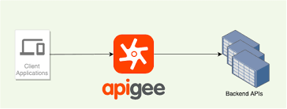
Features of Apigee
Apigee can be availed as a subscription model through which the API management platform can be utilized. Its features include:
Connects the current user interface with traditional data stores.
Automates documentation of APIs and software development kits.
Supports both the hybrid cloud and multi-cloud.
Collaborates the analytics and machine learning
Provides tools to monitor and troubleshoot API with security and optimization.
Scalable as per the requirements.
Java Full Stack Program

Slide 21
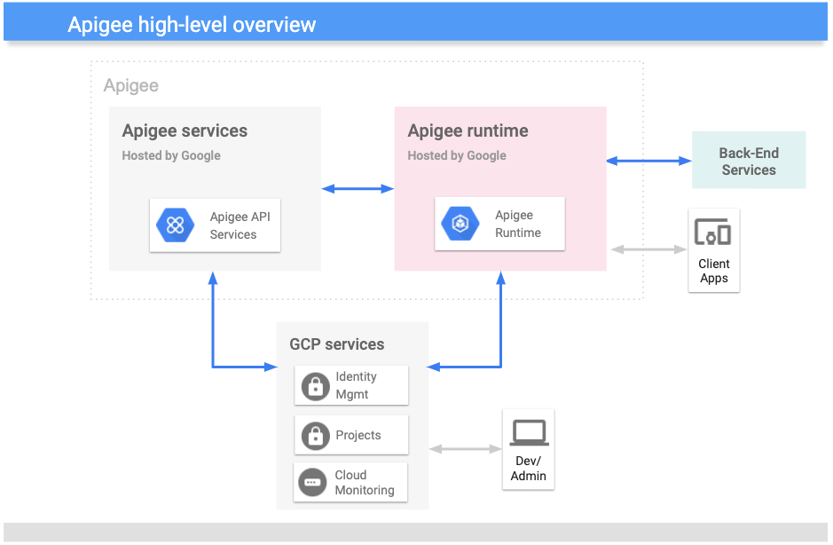
Java Full Stack Program

Slide 22
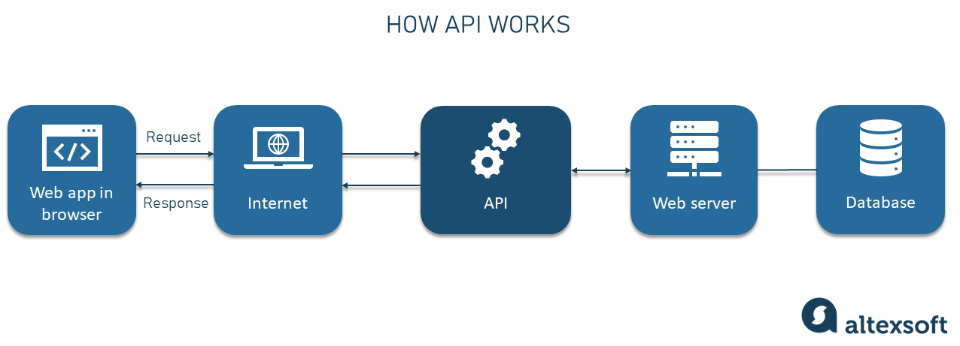
Basic Terminologies used in Apigee
Terminologies associated with Apigee include API, API basepath and resources, API proxy, API product, app, environment, organization, policy, API Resource path, Version, and Revision. While talking about API basepath and resources, it is noted that an API can be defined by a system of network addresses and URIs, which is made up of a base path and a group of resources. The policies and codes are attached to URIs that ensure control of APIs through Edge facilities
Java Full Stack Program

Slide 23
API
API, an interface which makes it simple for one app to burn-through capacities or information from different apps. Through characterizing steadily, streamlined passage focuses on app information, APIs empower designers to handily get to and reuse app logic provided by different engineers. On account of Web APIs information is uncovered over the organization. Apps that burn-through APIs are prone to alterations. The contract/agreement implied by API gives some degree of affirmation that, in the long run, the API will change in an anticipated way. Apigee Edge empowers you to construct APIs adding an administration and visibility option. On the off chance that you have HTTP empowered administrations, for example, SOA-based Web administrations, it can be uncovered as APIs through Apigee Edge. Edge additionally empowers you to fabricate APIs by actualizing apps facilitated on the API Services having no backend administration included. You can construct apps in Java, JavaScript, and Node.js.
Java Full Stack Program

Slide 24
API Proxy
By executing APIproxies you can uncover APIs in Apigee Edge. The API proxies dissociate the application confronting API from backend administrations, protecting those applications from backend code alterations. While creating backend changes to your administrations, applications keep on calling similar API with no interference. The two sorts of endpoints in an API Proxy setup are:
ProxyEndpoint: It explains the way customer applications devour your APIs. You design the ProxyEndpoint to characterize the URL of the API proxy. This endpoint additionally decides if applications could avail the proxy on HTTPS or HTTP. You can join strategies to the ProxyEndpoint to implement security, amount checks, and different kinds of access commands and rate-restricting.
Java Full Stack Program

Slide 25
TargetEndpoint: It explains the manner in which the API proxy collaborates with backend administrations. You design the TargetEndpoint to advance solicitations to the best possible backend administration, including characterizing any security conditions, HTTP or HTTPS, and other association data.
You can connect arrangements to the TargetEndpoint to guarantee that reaction messages are appropriately designed for the application which made the underlying solicitation.
API proxy can be defined as a collection of policies and file configurations that depends on a collection of resources contributed by Apigee Edge. These proxies are generated by the Apigee Edge management UI. It can be completed through using a text editor. It enables alteration without affecting the teams and shields developers from code changes. While making changes, they maintain the interface constant. It exposes you to numerous interfaces while meeting with developer requirements and also customizes the trademark of that particular API.
Java Full Stack Program

Slide 26
API Products
An API Products are collections of API resources (URIs) connected with a service plan, which is issued to app developers at design time. These can be bundled into API packages for monetization. It acts as a binding between an app and the bundle of URIs that the app is permitted to consume. API keys are bound to one or more API products.
Environments
Environments are a particular runtime execution context for API proxies. Proxies must be set up to an environment as its exposure is achieved on the network. Two environments provisioned by organizations are test and prod. The test is used for expanding API proxies during development. The prod can be utilized for promoting proxies from the test environment.
Java Full Stack Program

Slide 27
API development lifecycle
Software development life cycle is unique for every organization. This is much needed to unify API proxy deployment along with the processes that you use for developing and testing other applications. RESTful APIs help to combine API proxy deployment and management into the organization's Software development life cycle. We have already discussed the two environments and the distinction between both are arbitrary, as they are identified by completely different sets of URLs. Default (http address)and secure(https address) are Virtual Hosts.
Development tools
APIs are developed as per consumer app requirements. Apigee Edge UI, a browser-based tool can be used to create, configure, and manage API proxies and API products. It helps to create API proxies by editing code and checking request flows through your proxies. It creates API products that meet client requests. It manages developers and developer apps. It configures test and production environments.
Java Full Stack Program

Slide 28
Characteristics of API proxy development
APIs are entry points for one application to use the benefits of another. In Apigee Edge, API proxies are configured with API proxy logic as a chain of steps that are
executed according to the request from client code. API proxy is exposed to clients by detailing the endpoints.
The order of API proxy logic is arranged using flows.
Data is accessed through these flow variables.
Conditions are applied while executing API Proxies
Reusable sets of functionality are used and debugging is done with a trace tool.
Proxy errors are marked as faults.
Java Full Stack Program

Slide 29
Components of Apigee
Apigee services: The APIs which you utilize to make, operate, and send the API proxies.
Apigee runtime: A bunch of compartmentalized runtime administrations in a Kubernetes group which Google keeps up. All the API traffic is prepared and goes through the given administrations.
GCP administrations: It assures logging facilities, identity management, investigation, measurements, and tasks managing capacities.
Back-end services: It is utilized by your applications to give runtime admittance to information to the API proxies.
Flavors of Apigee
Apigee: A facilitated SaaS form in which Apigee keeps up the conditions, permitting you to focus on building administrations and characterizing the APIs to the given administrations.
Apigee hybrid:An adaptation type comprising of a runtime plane that is introduced on-premises or in a cloud supplier of one’s decision, and an administration plane operating in Apigee's cloud. API traffic and information are limited to your own undertaking affirmed limits in this model.
Java Full Stack Program

Slide 30
Services available through Apigee
Apigee empowers you to furnish secure admittance to your administrations with a characterized API which is steady over all administrations, paying little interest to support execution.
A reliable API:
Creates it simple for application designers to devour the services.
Empowers you to alter the backend administration execution without influencing the public API.
Empowers you to exploit the analytics, and different highlights incorporated into Apigee
Instead of having application designers burn-through the administrations, they utilize an API proxy made on Apigee. This capacities as a planning of a freely accessible
HTTP endpoint to your backend administration. Through making an API proxy allows Apigee to manage the security.
Java Full Stack Program

Slide 31
administrations, just as to investigate and screen those administrations.
Since application designers create HTTP solicitations to an API proxy, engineers don't have to be aware about the execution of your administrations. All the designer requires to know is:
API proxy endpoint’s URL.
Any inquiry tools, headers, or body boundaries accepted in a solicitation.
Any necessary verification and approval qualifications.
The configuration of the reaction, including the reaction information format, for example, XML or JSON.
The API proxy disengages the application designer from your backend administration. Along these lines you are allowed to alter the administration execution till the public API stays predictable. For instance, you can alter a database execution, shift administrations to another host, or roll out some other improvements to the services. By keeping up a steady frontend API, existing customer applications will keep on working, paying little heed to changes on the backend.
Java Full Stack Program

Slide 32
THANK YOU
Java Full Stack Program

